Slide 1

Chapter 4
Software Testing: A Craftsman’s Approach, 4th Edition Chapter 4 Graph Theory for Testers
Graph Theory for Testers
Graph theory for Testers

Slide 2
Linear Graph Theory
A branch of topology—focus on connections
(undirected) Graphs
  nodes, edges, matrices
  degree of a node
  Paths
  Components
Directed graphs
  nodes, edges
  indegree, outdegree
  paths and semi-paths
  n-connectedness
  cyclomatic number
  strong and weak components
  Program Graphs

Slide 3
Biblical advice…
“Test everything; keep that which is good”
1 Thessalonians 5:21
[Graph theory will help us understand the “everything” part.]

Slide 4
Linear Graphs
Definition 1: A graph G = (V, E) is composed of a finite (and nonempty) set V of nodes and a set E of unordered pairs of nodes.
When drawn, graphs usually show nodes as circles, and edges as lines.
Leonhard Euler developed graphs as a way to solve the “Bridges of Königsberg” puzzle in 1735.
(Königsberg, Prussia is now Kaliningrad, Russia)

Slide 5
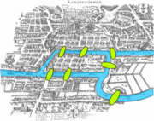
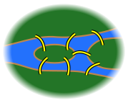
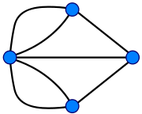
Bridges of Königsberg Puzzle
(http://en.wikipedia.org/wiki/Seven_Bridges_of_Köninigsberg)
Take a walk around the city, traversing each bridge exactly once.
Euler’s formulation made the problem easier to solve.
(It is impossible)
Nice example of using math to solve an abstract problem.

Slide 6
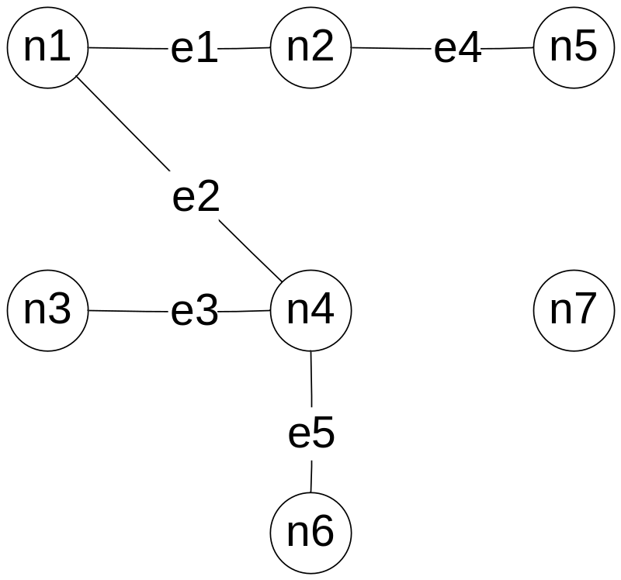
Linear Graph (running example)
V = {n1, n2, n3, n4, n5, n6, n7}
E = {e1, e2, e3, e4, e5}
= {(n1, n2), (n1, n4), (n3, n4), (n2, n5), (n4, n6)}

Slide 7
Degree of a Node
Definition 2: The degree of a node in a graph is the number of edges that have that node as an endpoint.
We write deg(n) for the degree of node n.
“popularity” of a node in a graph
Social scientists use graphs to describe
  social interactions
  friendship
  communication

Slide 8
Degree of a Node
deg(n1) = 2
deg(n2) = 2
deg(n3) = 1
deg(n4) = 3
deg(n5) = 1
deg(n6) = 1
deg(n7) = 0

Slide 9
Incidence Matrix of a Graph
Definition 3: The incidence matrix of a graph G = (V, E) with m nodes and n edges is an m by n matrix, where the element in row i, column j is a 1 if and only if node i is an endpoint of edge j; otherwise, the element is 0.

Slide 10
Sample Incidence Matrix
(What must be true about columns in an incidence matrix?)
 | e1 | e2 | e3 | e4 | e5
n1 | 1 | 1 | 0 | 0 | 0
n2 | 1 | 0 | 0 | 1 | 0
n3 | 0 | 0 | 1 | 0 | 0
n4 | 0 | 1 | 1 | 0 | 1
n5 | 0 | 0 | 0 | 1 | 0
n6 | 0 | 0 | 0 | 0 | 1
n7 | 0 | 0 | 0 | 0 | 0

Slide 11
Adjacency Matrix of a Graph
Definition 4: The adjacency matrix of a graph G = (V, E) with m nodes is an m by m matrix, where the element in row i, column j is a 1 if and only if an edge exists between node i and node j; otherwise, the element is 0.
This matrix can be used to answer questions about a program...
  reachability
  points affected by a fault
  connectedness in a program
Question: Why is this adjacency matrix symmetric?

Slide 12
Sample Adjacency Matrix
 | n1 | n2 | n3 | n4 | n5 | n6 | n7
n1 | 0 | 1 | 0 | 1 | 0 | 0 | 0
n2 | 1 | 0 | 0 | 0 | 1 | 0 | 0
n3 | 0 | 0 | 0 | 1 | 0 | 0 | 0
n4 | 1 | 0 | 1 | 0 | 0 | 1 | 0
n5 | 0 | 1 | 0 | 0 | 0 | 0 | 0
n6 | 0 | 0 | 0 | 1 | 0 | 0 | 0
n7 | 0 | 0 | 0 | 0 | 0 | 0 | 0

Slide 13
Paths in a Graph
Definition 5: A path is a sequence of edges such that, for any adjacent pair of edges ei, ej in the sequence, the edges share a common (node) endpoint.
Paths capture/express connectivity.
Paths can be described by
  sequences of nodes, or
  sequences of edges

Slide 14
Some Paths
path between
  n1 and n5 n1, n2, n5 e1, e4
  n6 and n5 n6, n4, n1, n2, n5 e5, e2, e1, e4
  n3 and n2 n3, n4, n1, n2 e3, e2, e1

Slide 15
Connectedness
Definition 6: Two nodes are connected if and only if they are in the same path.
Question: Is connectedness in a graph an equivalence relation?
From Chapter 3, to be an equivalence relation, connectedness must be
  reflexive
  symmetric
  transitive

Slide 16
Components of a Graph
Definition 7: A component of a graph is a maximal set of connected nodes.
Question: Does connectedness help define components?
Components are “maximal”

Slide 17
Components of “our” Graph
C1 = {n1, n2, n3, n4, n5, n6}
C2 = {n7}

Slide 18
Condensation Graphs
Definition 8: Given The condensation graph of a graph G = (V, E) is formed by replacing each component of G by a condensing node.
Questions:
  Draw the condensation graph of our running example.
  Can there be any edges in a condensation graph?

Slide 19
Cyclomatic Number of a Graph
Definition 9: The cyclomatic number of a graph G is given by V(G) = e – n + p, where
  e is the number of edges in G
  n is the number of nodes in G
  p is the number of components in G
Cyclomatic complexity pertains to both ordinary and directed graphs (next topic).
V(G) is sometimes called McCabe Complexity after Thomas McCabe.
The graph must be strongly connected.
(not very useful on our running example becsue it is not strongly connected)

Slide 20
Cyclomatic Complexity of “our” Graph
V(G) = e – n + p
= 5 – 7 + 2
= 0

Slide 21
Directed Graphs
Definition 10: A directed graph (or digraph) D = (V, E) consists of a finite set V of nodes, and a set E of edges, where each edge ek = <ni, nj> is an ordered pair of nodes ni, nj ϵ V.
<x, y> is an ordered pair
(x, y) is an unordered pair
For an edge <a, b> in a directed graph, node a is the initial node, and node b is the terminal node..

Slide 22
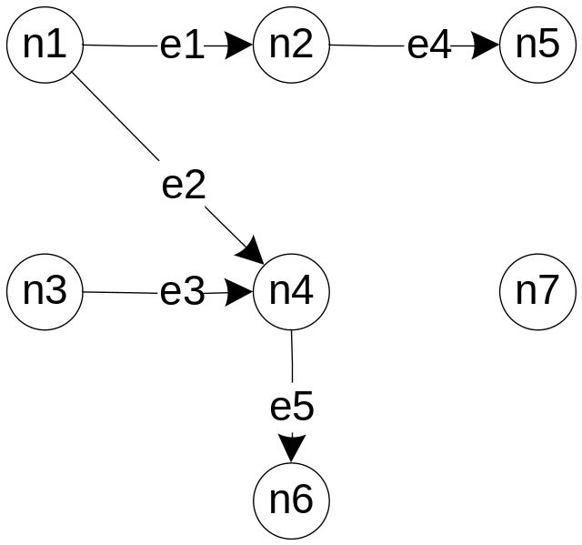
Directed Graph (revised example)
V = {n1, n2, n3, n4, n5, n6, n7}
E = {e1, e2, e3, e4, e5}
= {<n1, n2>, <n1, n4>, <n3, n4>, <n2, n5>, <n4, n6>}

Slide 23
Indegrees and Outdegrees of a Node
Definition 11: The indegree of a node in a directed graph is the number of distinct edges that have the node as a terminal node.
Definition 12: The outdegree of a node in a directed graph is the number of distinct edges that have the node as a start point.
We write indeg(n) and outdeg(n).

Slide 24
Indegrees and Outdegrees
indeg(n1) = 0 outdeg(n1) = 2
indeg(n2) = 1 outdeg(n2) = 1
indeg(n3) = 0 outdeg(n3) = 1
indeg(n4) = 2 outdeg(n4) = 1
indeg(n5) = 1 outdeg(n5) = 0
indeg(n6) = 1 outdeg(n6) = 0
indeg(n7) = 0 outdeg(n7) = 0

Slide 25
Types of Nodes
Definition 13:
A node with indegree = 0 is a source node.
A node with outdegree = 0 is a sink node.
A node with indegree ≠ 0 and outdegree ≠ 0
is a transfer node
Question: What are the source, sink, and transfer nodes in our continuing example?

Slide 26
Adjacency Matrix
Definition 14: The adjacency matrix of a directed graph D = (V, E) with m nodes is an m by m matrix
A = (a(i, j)) where a(i, j) is a 1 if and only if there is an edge from node i to node j; otherwise, the element is 0
Only in very special graphs are the adjacency matrices symmetric.

Slide 27
Adjacency Matrix
 | n1 | n2 | n3 | n4 | n5 | n6 | n7
n1 | 0 | 1 | 0 | 1 | 0 | 0 | 0
n2 | 0 | 0 | 0 | 0 | 1 | 0 | 0
n3 | 0 | 0 | 0 | 1 | 0 | 0 | 0
n4 | 0 | 0 | 0 | 0 | 0 | 1 | 0
n5 | 0 | 0 | 0 | 0 | 0 | 0 | 0
n6 | 0 | 0 | 0 | 0 | 0 | 0 | 0
n7 | 0 | 0 | 0 | 0 | 0 | 0 | 0

Slide 28
Adjacency Matrix Questions
Can indegrees and outdegrees of a node be derived (observed) in an adjacency matrix of a directed graph?
Can types of nodes (source, sink, transfer) be derived (observed) in an adjacency matrix of a directed graph?
Can paths be derived (observed) in an adjacency matrix of a directed graph? Hint: think about powers of an adjacency matrix.

Slide 29
Paths in a Directed Graph
Definition 15: A (directed) path is a sequence of edges such that, for any adjacent pair of edges ei, ej, in the sequence, the terminal node of the first edge is the initial node of the second edge.
Some related definitions...
  A cycle is a path in which some node is both the initial and the final node in the path.
  A chain is a sequence of nodes in which every interior node has indegree = outdegree = 1
  A semipath is a sequence of edges such that at least one node is either the initial node or the terminal node of two adjacent edges in the sequence.

Slide 30
Directed Graph (new example)
V = {n1, n2, n3, n4, n5, n6, n7}
E = {e1, e2, e3, e4, e5}
= {(n1, n2), (n1, n4), (n3, n4),
(n2, n5), (n4, n6)}
There is a path from n1 to n6, and there are semipaths between nodes n1 and n3, n2 and n4, and between nodes n5 and n6.

Slide 31
Questions
List the chains in our continuing example.
What is/are the longest path(s)?
Are there any cycles?
How would you describe the difference between semipaths <n3, n4, n5> and <n4, n1, n2>?
Is <n6, n4, n1, n2, n5> a semipath?

Slide 32
Reachability Matrix
Definition 16: The reachability matrix of a directed graph D = (V, E) with m nodes is an m by m matrix
R = (r(i, j)), where r(i, j) is a 1 if and only if there is a path from node i to node j, otherwise the element is 0.
Reachability is closely related to paths.
The reachability matrix R can be computed using the adjacency matrix A of the directed graph:
  R = I + A + A² + A³ + ... + A^{k}
  where k is the length of the longest path in D,
  I is the identity matrix, and
  powers of A are computed by slightly changed matrix multiplication in which 1 + 1 = 1

Slide 33
Reachability Matrix
 | n1 | n2 | n3 | n4 | n5 | n6 | n7
n1 | 1 | 1 | 0 | 1 | 1 | 1 | 0
n2 | 0 | 1 | 0 | 0 | 1 | 0 | 0
n3 | 0 | 0 | 1 | 1 | 0 | 1 | 0
n4 | 0 | 0 | 0 | 1 | 0 | 1 | 0
n5 | 0 | 0 | 0 | 0 | 1 | 0 | 0
n6 | 0 | 0 | 0 | 0 | 0 | 1 | 0
n7 | 0 | 0 | 0 | 0 | 0 | 0 | 1

Slide 34
Compute A²
 | n1 | n2 | n3 | n4 | n5 | n6 | n7
n1 | 0 | 1 | 0 | 1 | 0 | 0 | 0
n2 | 0 | 0 | 0 | 0 | 1 | 0 | 0
n3 | 0 | 0 | 0 | 1 | 0 | 0 | 0
n4 | 0 | 0 | 0 | 0 | 0 | 1 | 0
n5 | 0 | 0 | 0 | 0 | 0 | 0 | 0
n6 | 0 | 0 | 0 | 0 | 0 | 0 | 0
n7 | 0 | 0 | 0 | 0 | 0 | 0 | 0
 | n1 | n2 | n3 | n4 | n5 | n6 | n7
n1 | 0 | 1 | 0 | 1 | 0 | 0 | 0
n2 | 0 | 0 | 0 | 0 | 1 | 0 | 0
n3 | 0 | 0 | 0 | 1 | 0 | 0 | 0
n4 | 0 | 0 | 0 | 0 | 0 | 1 | 0
n5 | 0 | 0 | 0 | 0 | 0 | 0 | 0
n6 | 0 | 0 | 0 | 0 | 0 | 0 | 0
n7 | 0 | 0 | 0 | 0 | 0 | 0 | 0
 | n1 | n2 | n3 | n4 | n5 | n6 | n7
n1
n2
n3
n4
n5
n6
n7

Slide 35
n-Connectedness
Definition 17: Nodes n_{j} and n_{k} in a directed graph are
  0-connected iff no path (or semipath) exists between n_{j} and n_{k}
  1-connected iff a semi-path but no path exists between n_{j} and n_{k}
  2-connected iff a path exists from n_{j} and n_{k}
  3-connected iff a path goes from n_{j} to n_{k} and a path goes from n to n_{k}
No other degrees of n-connectedness exist
A new edge, e6, is added to our continuing example.
n-connectedness has very useful expressive power.

Slide 36
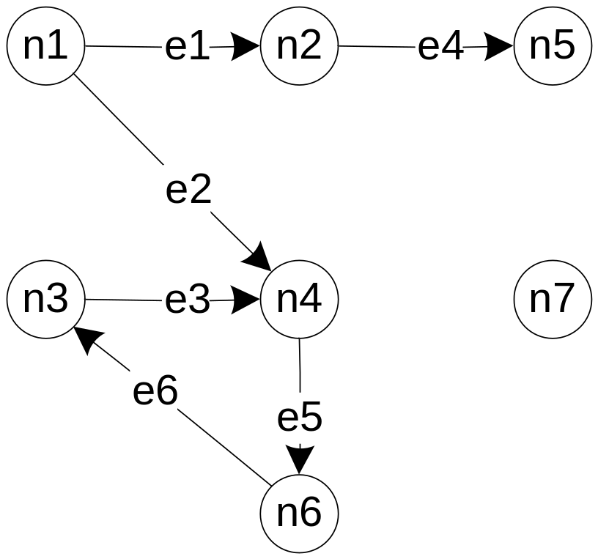
Directed Graph (third version)
Is 3-connectedness an equivalence relation?

Slide 37
Directed Graph (third version)
Find examples of a chain, a cycle, a set of 3-connected nodes

Slide 38
Strong Components of a Directed Graph
Definition 18: A strong component of a directed graph is a maximal set of 3-connected nodes.
Strong components...
  identify loops and isolated nodes.
  lead to another form of condensation graph
  support an excellent voew of testing programs with loops

Slide 39
Directed Graph (third version)
Strong components: S1 = {n3, n4, n6}, S2 = {n7}

Slide 40
Condensation Graph of a Directed Graph
Definition 19: Given a directed graph D = (V, E), its condensation graph is formed by replacing strongly connected nodes by their corresponding strong components.
A condensation graph of a directed graph...
  contains no loops, and is therefore
  a Directed Acyclic Graph (DAG)
  support an excellent view of testing programs with loops

Slide 41
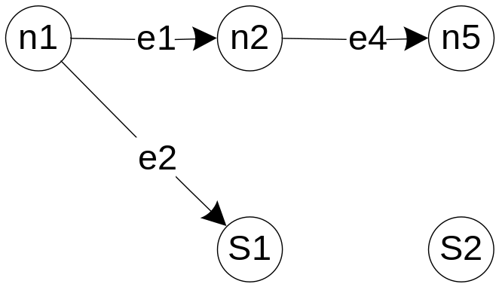
Condensation Graph of Directed Graph (third version)
Strong components: S1 = {n3, n4, n6}, S2 = {n7}

Slide 42
Program Graphs
Definition 20: The program graph of a program written in an imperative programming language is a directed graph in which nodes are either entire statements or statement fragments. There is an edge from node i to node j if and only if node j can be executed immediately after node i).
(The early (1970s) definitions referred to nodes as entire statements, but this doesn’t fit well with modern programming languages.)
We shall use “statement fragment” to refer either to full statements or to statement fragments.

Slide 43
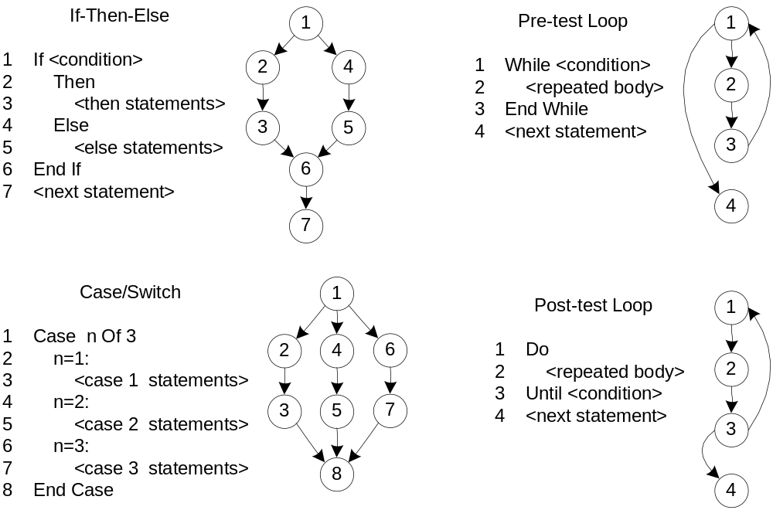
Program Graphs
When drawing a program graph, it is usually simpler to number the statement fragments.
This Figure 8.1

Slide 44
Four Graph-Based Models
Finite State Machines
Petri Nets
Event-Driven Petri Nets
StateCharts
These are all executable models, i.e., it is possible to build a program (an engine) to execute the model.

Slide 45
Finite State Machines (FSMs)
Finite State Machines are directed graphs in which nodes are states, and edges are transitions from one state to a successor state.
Transitions are caused by
  events
  date conditions
  passage of time (an event)
Constraints
  states are mutually exclusive
  only one transition can occur at a time
FSMs are ideally suited for menu-driven applications

Slide 46
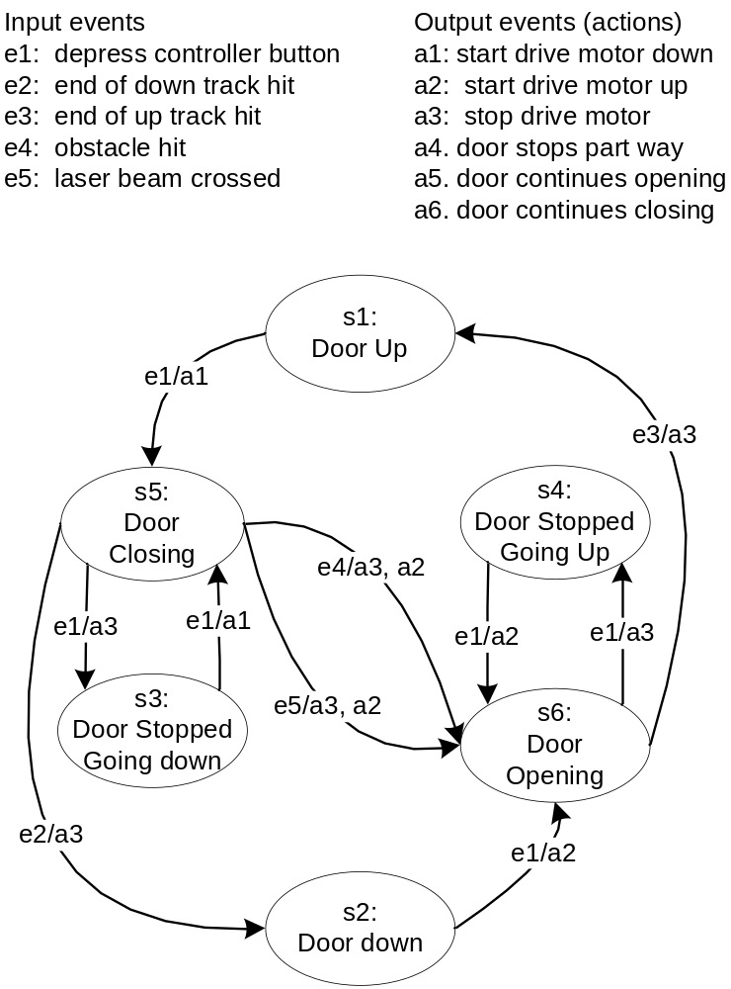
Garage Door Controller FSM

Slide 47
Petri Nets
Petri Nets are bipartite directed graphs (P, T, In, Out), where
  P is a set of places
  T is a set of transitions
  In is a mapping of places to transitions, understood as input places
  Out is a mapping of to transitions to places , understood as output places
Finite State Machines are a special case of Petri Nets.

Slide 48
Petri Nets (continued)
Petri Net execution is governed by
  place markings
  transition enabling and firing
  several strategies for transition firing sequences
Constraints
  only one transition at a time can be fired
  no simultaneous events
Petri Nets can express a variety of complex situations.

Slide 49
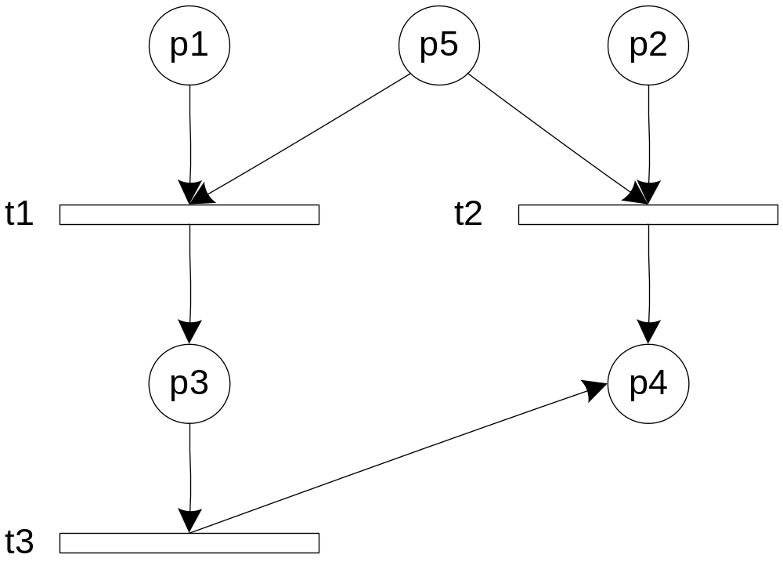
Petri Net Example

Slide 50
Petri Net Exercise
Identify the following for the sample Petri Net
  the set P of places
  the set T of transitions
  the mapping In of inputs to transitions
  the mapping out of outputs of transitions

Slide 51
Event-Driven Petri Nets (EDPNs)
Definition 21: An Event-Driven Petri Net is a tripartite-directed graph (P, D, S, In, Out) composed of three sets of nodes, P, D, and S, and two mappings, In and Out, where:
  P is a set of port events
  D is a set of data places
  S is a set of transitions
  In is a set of ordered pairs from (P ∪ D) ˣ S
  Out is a set of ordered pairs from S ˣ (P ∪ D)

Slide 52
Event-Driven Petri Nets (continued)
Port events can be
  input events
  output events
  drawn as triangles
Places are as in ordinary Petri Nets
Transition firing is a simple extension of ordinary Petri Net transition firing
(there are no output events in the example on the next slide)

Slide 53
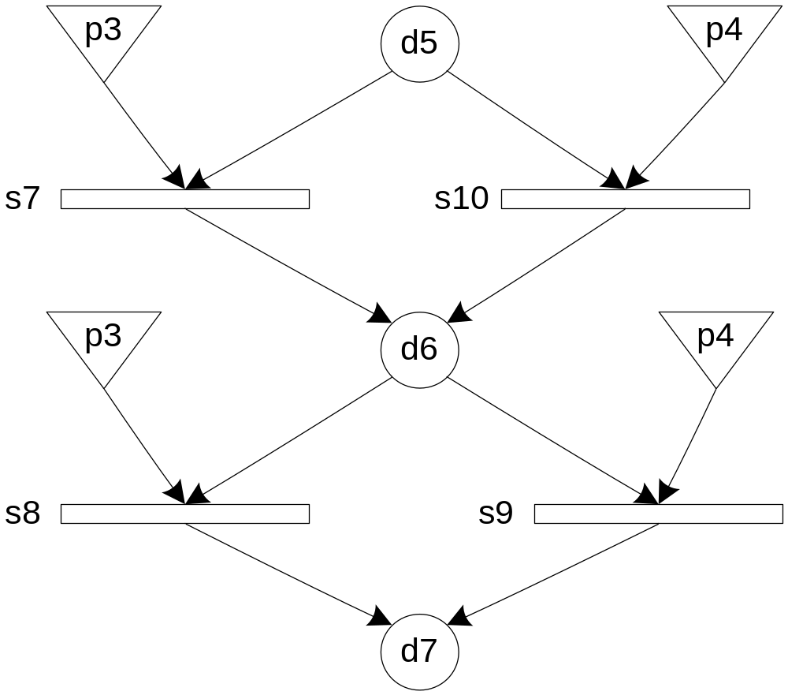
EDPN Example

Slide 54
StateCharts
Created by David Harel
Harel’s goal was to combine the visual expressive power of
  directed graphs
  Venn diagrams
“States” can contain...
  lower level states
  concurrent regions
Transitions are very elaborate (see text)
StateCharts are an elegant resolution to the “Finite State Machine Explosion”

Slide 55
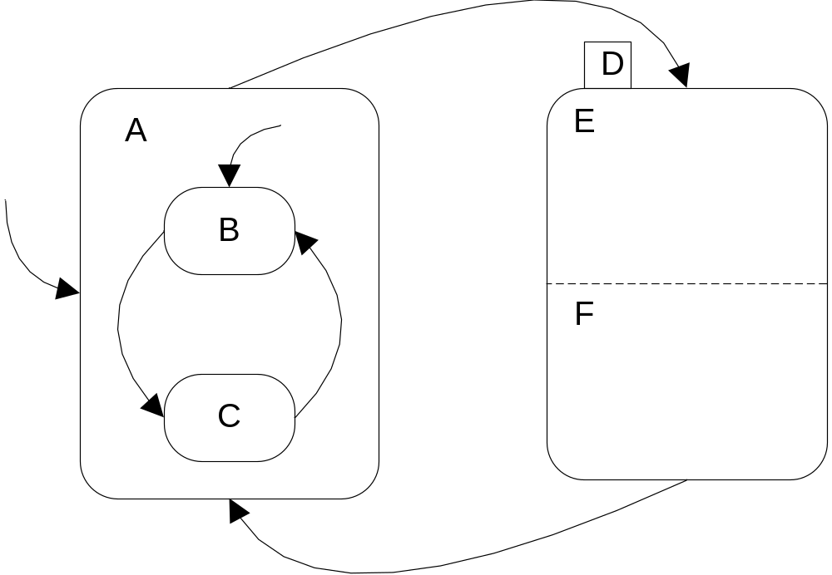
Sample StateChart
Blob (state) A contains two lower level states.
Blob B contains two concurrent regions, E and F.

Slide 56
Wrap-Up
Graph theory is a powerful way to express many of the concepts of software testing.
It will be used extensively inh sequel chapters.
The graph-based models all lead to (and support) model-based testing.
Executable models support nearly automatic generation (derivation) of system level test cases.

